Slide 1
Forming a solid foundation of general education knowledge and basic knowledge of Environmental Engineering
Calculate, design and research environmental treatment facilities suitable to circumstance need based on professional knowledge
Curriculum objectives
Proficient use of self-study skills, problem solving skills in basic research in Environmental Engineering
POs
Be able to use professional skills and creative thinking in research, design, and operation of waste treatment and resource recycling systems
Effective communication, organization, leadership and teamwork. Capable of grasping social needs, well performing social responsibilities and professional ethics

Slide 2
Applying basic knowledge of atmospheric, soil and water environment into EE
Proficient use of English
08
01
07
02
Applying knowledge in collecting data and analyzing impacting factors
Effective communication
PLOs
06
03
Be able to explain event and phenomenon occuring in the environment
Applying and analyzing material transforming reactions in the environment
05
04
Understand and be able to apply law, regulation and standards in environmental and resource management
Applying skills in waste treatment

Slide 3
Applying research skills on issues related to waste treatment in the environment
Be respectful to everyone
16
09
15
10
Applying skills on computing, designing experimental models and piloting models to choose optimal parameters
Compliance in communication and behavior
PLOs
14
11
Emphasize on responsibility for the environment and resources
Applying skills in operating waste treatment systems in reality
13
12
Emphasize on social responsibility
Applying knowledge of environmental laws and policies to waste treatment works

Slide 4
The relationship between Program Outcomes (POs) and Program Learning Outcomes (PLOs)

Slide 5
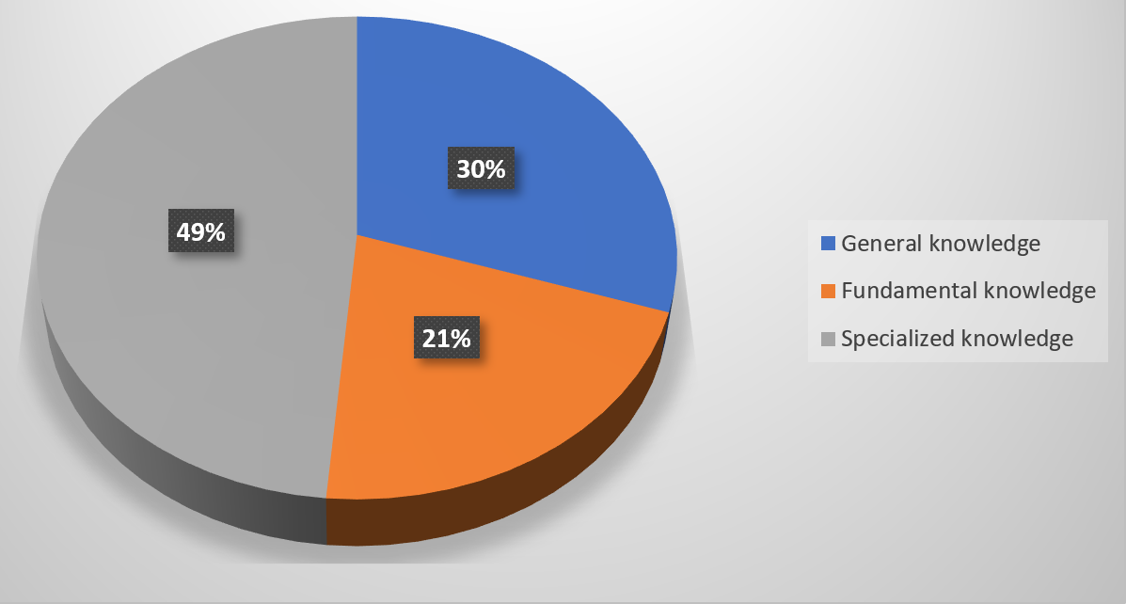
The logic structure of the EE program

Slide 6
The staff to student ratio of FTE
Academic Years | Total FTE of academic staff | Total Students of EE Program | Ratio
2015-2016 | 20 | 236 | 1/16
2016-2017 | 20 | 245 | 1/16
2017-2018 | 20 | 220 | 1/16
2018-2019 | 20 | 241 | 1/16
2019-2020 | 20 | 226 | 1/16

